Slide 1
Petrologia e Geodinamica
Laurea Magistrale in
Geologia di Esplorazione
Dipartimento di Scienze della Terra
Università degli Studi di Roma La Sapienza
Michele Lustrino
(michele.lustrino@uniroma1.it. Tel: 06 49914158. Stanza 114)

Slide 2
Part Five.
The role of hydrous minerals;
Supra-subduction mantle melting.

Slide 3
Where are volatiles stored in the solid mantle?
CO₂ is stored in subsolidus dolomite at depths >~70 km (~2 GPa) or magnesite at depths >~100 km (~3 GPa).
H₂O is stored in different silicates containing up to 15 wt% H₂O.
At depths >300 km, H₂O is stored in DHMS (Dense Hydrous Magnesium Silicates) like Brucite [Mg(OH)₂] and Wadsleyite at P = 410-520 km.
High pressure phases of (Mg,Fe)₂SiO₄ @ 1200 °C
6
α
8
Olivine
structure
α + γ
10
Pressure (Gpa)
γ
Remember Wadsleyite?
12
Spinel
structure
α+β
β
+
γ
β-Olivine
14
β
100
80
60
40
20
0
Mole % Mg₂SiO₄

Slide 4
Where are volatiles stored in the solid mantle?
The olivine–wadsleyite transformation in the Mg₂SiO₄-Fe₂SiO₄ system calculated at 1400 °C under dry conditions and with 0.4 wt% H₂O.
The higher the H₂O content, the shallower the olivine-wadsleyite transition.
The ol-wad transition can be easily identified by seismology → hygrometer
Frost, 2008 (Elements, 4, 171-176)

Slide 5
Where are volatiles stored in the solid mantle?
The downward displacement of the two-phase region in the hydrous system is shown by the red curves. The vertical dashed line shows a typical mantle Fe/(Fe+Mg) ratio of 0.1. The dry transition is approximately 7 km wide, while the addition of H₂O broadens the transition at these conditions to a maximum of 11 km.
Frost, 2008 (Elements, 4, 171-176)

Slide 6
The effects of water:
Water:
1. Has a large effect on the mantle solidus;
2. Is also responsible for the broadening of the melting zone under mid-ocean ridges;
3. Is responsible for the initiation of melting in subduction zones;
4. Drastically changes the liquid line of descent of basaltic magmas (it is responsible for the calcalkaline versus tholeiitic differentiation trend).

Slide 7
Focus on Hydrous Mg Silicate Minerals
Experimental studies of hydrous systems under mantle pressures suggest the existence of several dense hydrous phases.
The major hydrous phases in pyrolite with increasing pressure are serpentine, chlorite, amphibole (pargasite) and so-called dense hydrous magnesium silicate (DHMS) phases: phase A, phase E, phase B (or phase C) and phase G (or phases D/F). The latter are known only in laboratory studies.
All these phases are stable at temperatures below 1300 °C (many are stable at temperature <900 °C). This strongly limits their stability only in the coldest and wettest portions of the mantle.
Most of the hydrous phases were synthesized via a simple silicate–water system or under water-saturated conditions.
Litasov and Ohtani,2003 (Phys. Chem. Mineral., 30, 147-156)

Slide 8
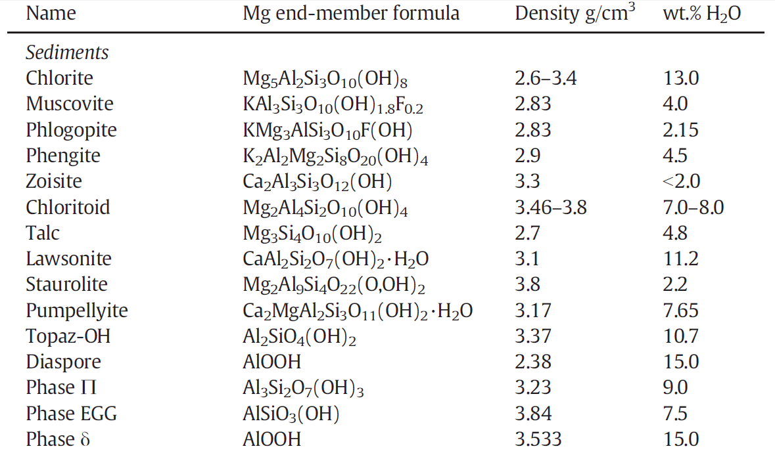
Density range: 2.6-3.8 g/cm³
What is the density of the lower mantle?
>3.9 g/cm³
Faccenda, 2014 (Tectonophysics, 614, 1-30)

Slide 9
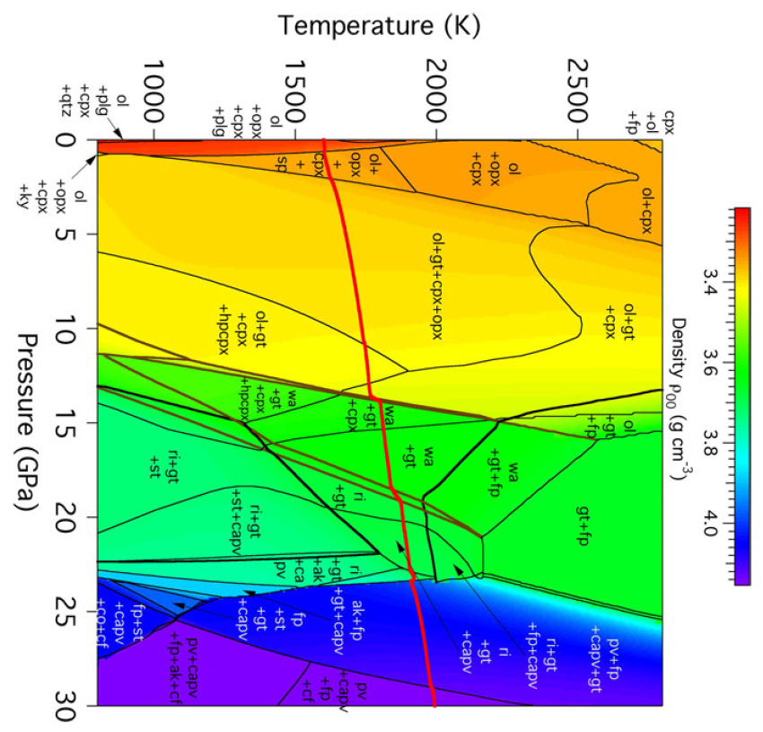
410 km
560 km
660 km
Stixrude and Lithgow-Bertelloni, 2011 (Geophys. J. Int., 184, 1180-1213)
Notes:
Il gradiente isentropico è uguale al gradient adiabatico (senza scambio di calore). A differenza del G. adiabatico, che può essere reversibile o irreversibile, il G. isentropico è sempre reversibile.

Slide 10
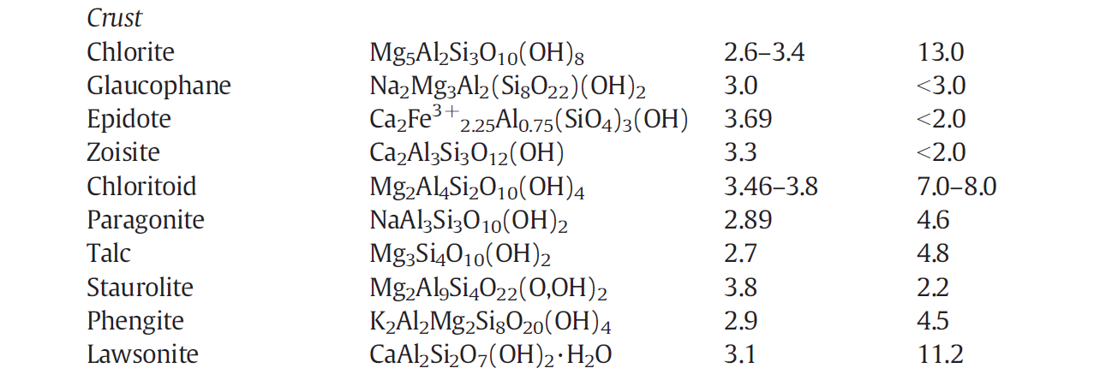
Density range: 2.6-3.8 g/cm³
What is the density of the lower mantle?
>3.9 g/cm³
Faccenda, 2014 (Tectonophysics, 614, 1-30)

Slide 11
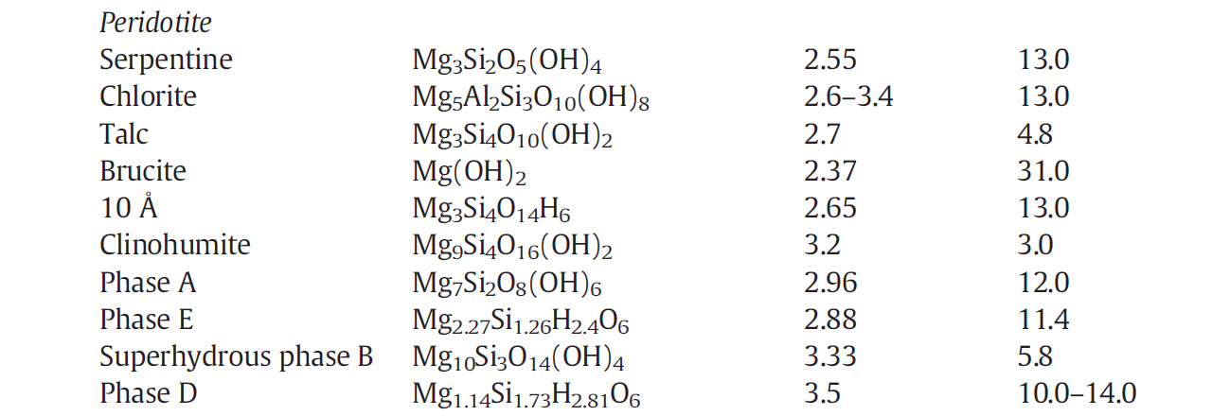
Pargasite NaCa₂(Mg,Fe)₄Al₃Si₆O₂₂(OH)₂ 3.2 2
Density range: 2.6-3.5 g/cm³
Is it possible for a subducting slab (sediments + basalt + peridotite) to pierce the base of the Transition Zone Mantle?
What is the density of the lower mantle?
>3.9 g/cm³
Faccenda, 2014 (Tectonophysics, 614, 1-30)

Slide 12
Principal hydrous phases in peridotites
The principal hydrous phases in H₂O-saturated peridotite to 8 GPa are serpentine, phase A, chlorite, talc, and amphibole.
Temperature (°C)
Talc = ~5 wt% H₂O
400
500
600
700
800
900
1000
1100
Serpent. = ~13 wt% H₂O
tc ol H₂O
amph ol H₂O
opx H₂O
Amph present
tc ol
opx ol sp H₂O
amph sp opx ol
solidus
serp chl cpx
serp
chl
Chlorite = ~13 wt% H₂O
1
Talc present
Talc absent
amph chl opx ol
serp chl amph ol
amph ol H₂O
sp
50
Amphibole = ~2 wt% H₂O
2
tc amph
chl ol
amph gar opx ol
gar
chl opx cpx
amph ol
70
Chlorite present
cpx gar opx H₂O
chl cpx opx ol
Chlorite absent
Phase A = ~12 wt% H₂O
3
serp chl cpx ol
chl opx
100
Serpent. present
serp
Serp. absent
Depth (km)
4
opx ol H₂O
ol gar H₂O
Amph absent
Pressure (GPa)
solidus
cpx opx ol gar
5
serp gar cpx ol
Phase A absent
150
‘A’ = phase A, amph = amphibole, chl = chlorite, cpx = clinopyroxene, gar = garnet, ol = olivine, opx = orthopyroxene, serp = serpentine, sp = spinel, tc = talc.
ol H₂O
serp phase A
serp phase A cpx gar
Peridotite
+ H₂O
180
6
serp
ol H₂O
200
7
“A” opx H₂O
“A” opx
phase A opx cpx gar
8
Phase A present
240
Schmidt and Poli, 1998 (Earth Planet. Sci. Lett., 163, 361-379)

Slide 13
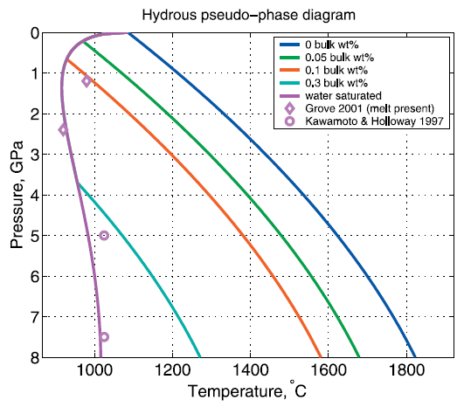
Principal hydrous phases in peridotites
The principal hydrous phases in H₂O-saturated peridotite to 8 GPa are serpentine, phase A, chlorite, talc, and amphibole.
Temperature (°C)
Talc = ~5 wt% H₂O
Wet solidus
400
500
600
700
800
900
1000
1100
Serpent. = ~13 wt% H₂O
tc ol H₂O
amph ol H₂O
opx H₂O
tc ol
opx ol sp H₂O
amph sp opx ol
solidus
serp chl cpx
serp
chl
Chlorite = ~13 wt% H₂O
1
amph chl opx ol
serp chl amph ol
amph ol H₂O
sp
50
Amphibole = ~2 wt% H₂O
2
tc amph
chl ol
amph gar opx ol
gar
chl opx cpx
amph ol
70
chl cpx opx ol
cpx gar opx H₂O
Phase A = ~12 wt% H₂O
3
serp chl cpx ol
chl opx
100
serp
Depth (km)
Katz et al., 2003 (G3 doi:10.1029/2002GC000433)
4
opx ol H₂O
ol gar H₂O
Pressure (GPa)
solidus
cpx opx ol gar
5
serp gar cpx ol
150
‘A’ = phase A, amph = amphibole, chl = chlorite, cpx = clinopyroxene, gar = garnet, ol = olivine, opx = orthopyroxene, serp = serpentine, sp = spinel, tc = talc.
ol H₂O
serp phase A
serp phase A cpx gar
Peridotite
+ H₂O
180
6
serp
ol H₂O
200
7
“A” opx H₂O
“A” opx
phase A opx cpx gar
8
240
Schmidt and Poli, 1998 (Earth Planet. Sci. Lett., 163, 361-379)

Slide 14
Principal hydrous phases in peridotites
The principal hydrous phases in H₂O-saturated peridotite to 8 GPa are serpentine, phase A, chlorite, talc, and amphibole.
Temperature (°C)
Temperature (°C)
600
700
800
900
400
500
600
700
800
900
1000
1100
1
tc ol H₂O
amph ol H₂O
opx H₂O
tc ol
opx ol sp H₂O
amph sp opx ol
solidus
serp chl cpx
serp
chl
2
Chlorite-out
1
amph chl opx ol
1
serp chl amph ol
amph ol H₂O
sp
50
2
amph gar opx ol
3
Amphibole
-out
tc amph
chl ol
2
gar
chl opx cpx
amph ol
70
chl cpx opx ol
cpx gar opx H₂O
serp chl cpx ol
Antigorite-out
3
3
100
4
chl opx
serp
Depth (km)
Absence of stable hydrous phases
4
opx ol H₂O
ol gar H₂O
4
Pressure (GPa)
Absence of stable hydrous phases
Pressure (GPa)
solidus
5
Pressure (GPa)
cpx opx ol gar
Phase 10 Å-out
5
serp gar cpx ol
5
150
Phase
10 Å
ol H₂O
Phase 10 Å not yet discovered in 1998
6
serp phase A
serp phase A cpx gar
Peridotite
+ H₂O
180
6
6
Phase A-in
serp
ol H₂O
200
7
7
“A” opx H₂O
“A” opx
7
phase A opx cpx gar
Fumagalli and Poli, 2005 (J. Petrol., 46, 555-578)
8
240
Schmidt and Poli, 1998 (Earth Planet. Sci. Lett., 163, 361-379)

Slide 15
Principal hydrous phases in peridotites
The principal hydrous phases in H₂O-saturated peridotite to 8 GPa are serpentine, phase A, chlorite, talc, and amphibole.
Wet Solidus
Temperature (°C)
Temperature (°C)
900
1000
1100
MORB pyrolite
-40% olivine
(+ 0.6% H₂O)
400
500
600
700
800
900
1000
1100
tc ol H₂O
amph ol H₂O
opx H₂O
tc ol
opx ol sp H₂O
amph sp opx ol
solidus
serp chl cpx
serp
chl
1
Pl-out
1
amph chl opx ol
Lherzolite + melt
Amphibole Lherzolite
serp chl amph ol
amph ol H₂O
sp
50
2
tc amph
chl ol
amph gar opx ol
gar
Pressure (GPa)
chl opx cpx
amph ol
70
2
chl cpx opx ol
cpx gar opx H₂O
Gar-in
3
serp chl cpx ol
chl opx
100
Niida and Green, 1999 (Contrib. Mineral. Petrol., 135, 18-40)
serp
Depth (km)
3
4
opx ol H₂O
ol gar H₂O
Amph-out
Pressure (GPa)
solidus
cpx opx ol gar
H₂O-undersaturated solidus
5
serp gar cpx ol
150
ol H₂O
Amphibole stability limit
serp phase A
serp phase A cpx gar
Peridotite
+ H₂O
180
6
serp
ol H₂O
200
7
“A” opx H₂O
“A” opx
phase A opx cpx gar
8
240
Schmidt and Poli, 1998 (Earth Planet. Sci. Lett., 163, 361-379)

Slide 16
Principal hydrous phases in peridotites
The principal hydrous phases in H₂O-saturated peridotite to 8 GPa are serpentine, phase A, chlorite, talc, and amphibole.
Temperature (°C)
Temperature (°C)
900
1000
1100
MORB pyrolite
-40% olivine
(+ 0.6% H₂O)
400
500
600
700
800
900
1000
1100
tc ol H₂O
amph ol H₂O
opx H₂O
tc ol
opx ol sp H₂O
amph sp opx ol
solidus
serp chl cpx
serp
chl
1
Pl-out
1
amph chl opx ol
Lherzolite + melt
Amphibole Lherzolite
serp chl amph ol
amph ol H₂O
sp
50
2
tc amph
chl ol
amph gar opx ol
gar
Pressure (GPa)
chl opx cpx
amph ol
70
2
chl cpx opx ol
cpx gar opx H₂O
Gar-in
3
serp chl cpx ol
chl opx
100
Niida and Green, 1999 (Contrib. Mineral. Petrol., 135, 18-40)
serp
Depth (km)
3
4
opx ol H₂O
ol gar H₂O
Amph-out
Pressure (GPa)
solidus
cpx opx ol gar
5
serp gar cpx ol
150
ol H₂O
serp phase A
Amph-out ~3 GPa
serp phase A cpx gar
Peridotite
+ H₂O
180
6
serp
ol H₂O
200
Who is wrong?
7
“A” opx H₂O
“A” opx
phase A opx cpx gar
240
Amph-out ~2 GPa
8
Schmidt and Poli, 1998 (Earth Planet. Sci. Lett., 163, 361-379)

Slide 17
Principal hydrous phases in peridotites
Stabilities of serpentine, phase A, and talc are expected to be almost identical for depleted or fertile peridotite because these phases are almost Ca- and Na-free and contain only minor amounts of Al₂O₃.
Serpent. Mg₃Si₂O₅(OH)₄
Temperature (°C)
Phase A Mg₇Si₂O₈(OH)₆
400
500
600
700
800
900
1000
1100
tc ol H₂O
Talc Mg₃Si₄O₁₀(OH)₂
amph ol H₂O
opx H₂O
tc ol
opx ol sp H₂O
amph sp opx ol
solidus
serp chl cpx
serp
chl
1
amph chl opx ol
50
The stabilities of chlorite and amphibole vary for harzburgitic, lherzolitic, and pyrolitic bulk compositions.
serp chl amph ol
amph ol H₂O
amph gar opx ol
sp
2
tc amph
chl ol
chl opx cpx
amph ol
gar
70
chl cpx opx ol
cpx gar opx H₂O
3
serp chl cpx ol
chl opx
100
serp
Depth (km)
4
opx ol H₂O
ol gar H₂O
Pressure (GPa)
solidus
cpx opx ol gar
5
serp gar cpx ol
150
ol H₂O
Chlorite Mg₅Al₂Si₃O₁₀(OH)₈
serp phase A
serp phase A cpx gar
Peridotite
+ H₂O
180
6
Amph NaCa₂(Mg,Fe)₄Al₃Si₆O₂₂(OH)₂
serp
ol H₂O
200
7
“A” opx H₂O
“A” opx
Why?
phase A opx cpx gar
8
240
Schmidt and Poli, 1998 (Earth Planet. Sci. Lett., 163, 361-379)

Slide 18
Principal hydrous phases in peridotites
Serpentine contains ~13 wt% H₂O and dominates, together with chlorite (~13 wt% H₂O), the water budget of hydrous peridotite to ~150 km depth.
Temperature (°C)
In average mantle compositions, talc (4.7 wt% H₂O) + olivine have a rather limited stability field less than 100 °C wide, and they decompose to enstatite + H₂O between 690 °C (1 GPa) and 720 °C (2 GPa).
400
500
600
700
800
900
1000
1100
tc ol H₂O
amph ol H₂O
opx H₂O
tc ol
opx ol sp H₂O
amph sp opx ol
solidus
serp chl cpx
serp
chl
1
amph chl opx ol
serp chl amph ol
amph ol H₂O
sp
50
2
tc amph
chl ol
amph gar opx ol
gar
chl opx cpx
amph ol
70
chl cpx opx ol
cpx gar opx H₂O
3
serp chl cpx ol
chl opx
100
serp
Depth (km)
4
opx ol H₂O
ol gar H₂O
Pressure (GPa)
solidus
cpx opx ol gar
5
serp gar cpx ol
150
ol H₂O
serp phase A
serp phase A cpx gar
Peridotite
+ H₂O
180
6
serp
ol H₂O
200
7
“A” opx H₂O
“A” opx
phase A opx cpx gar
8
240
Schmidt and Poli, 1998 (Earth Planet. Sci. Lett., 163, 361-379)

Slide 19
Principal hydrous phases in peridotites
In natural peridotites, chlorites have compositions close to clinochlor (Mg₅Al₂Si₃O₁₀(OH)₈). Synthetic clinochlor decomposes between 3 and 21 kbar to orthopyroxene + olivine + spinel + H₂O with a maximum temperature stability of 870 °C.
Temperature (°C)
In subducted peridotite, Phase A (Mg₇Si₂O₈(OH)₆, ~12 wt% H₂O) replaces serpentine at pressures between 6 and 7 GPa.
400
500
600
700
800
900
1000
1100
tc ol H₂O
amph ol H₂O
opx H₂O
tc ol
opx ol sp H₂O
amph sp opx ol
solidus
serp chl cpx
serp
chl
1
amph chl opx ol
serp chl amph ol
amph ol H₂O
sp
50
2
tc amph
chl ol
amph gar opx ol
gar
chl opx cpx
amph ol
70
chl cpx opx ol
cpx gar opx H₂O
3
serp chl cpx ol
chl opx
100
serp
Depth (km)
4
opx ol H₂O
ol gar H₂O
Pressure (GPa)
solidus
cpx opx ol gar
5
serp gar cpx ol
150
ol H₂O
serp phase A
serp phase A cpx gar
Peridotite
+ H₂O
180
6
serp
ol H₂O
200
7
“A” opx H₂O
“A” opx
phase A opx cpx gar
8
240
Schmidt and Poli, 1998 (Earth Planet. Sci. Lett., 163, 361-379)

Slide 20
Principal hydrous phases in peridotites
Close to the water-saturated solidus (approximately 1000 °C, at 2–3 GPa)
amphibole is pargasitic hornblende in composition and decomposes between 2.2 and 3 GPa.
Temperature (°C)
In harzburgite, calcic amphibole decomposes at ~2.2 GPa.
In lherzolite at ~2.5-2.8 GPa.
In enriched pyrolite at ~2.8-3.0 GPa.
400
500
600
700
800
900
1000
1100
tc ol H₂O
amph ol H₂O
opx H₂O
tc ol
opx ol sp H₂O
amph sp opx ol
solidus
serp chl cpx
serp
chl
1
amph chl opx ol
serp chl amph ol
amph ol H₂O
sp
50
2
tc amph
chl ol
amph gar opx ol
gar
chl opx cpx
amph ol
70
chl cpx opx ol
cpx gar opx H₂O
Amph-out range
3
serp chl cpx ol
chl opx
100
serp
Depth (km)
4
opx ol H₂O
ol gar H₂O
Pressure (GPa)
solidus
cpx opx ol gar
5
serp gar cpx ol
150
ol H₂O
serp phase A
serp phase A cpx gar
Peridotite
+ H₂O
180
6
serp
ol H₂O
200
7
“A” opx H₂O
“A” opx
phase A opx cpx gar
8
240
Schmidt and Poli, 1998 (Earth Planet. Sci. Lett., 163, 361-379)

Slide 21
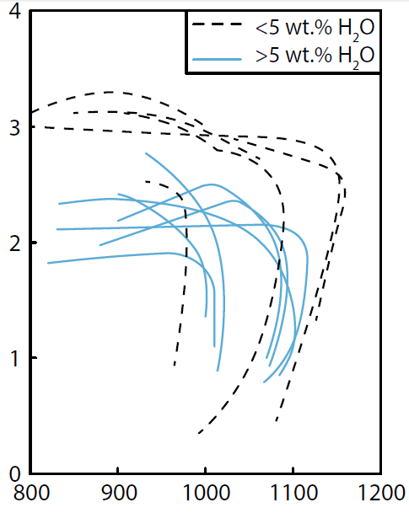
Principal hydrous phases in peridotites
Temperature (°C)
800
900
1000
1100
1200
Stability fields of amphibole in the mantle determined experimentally with different compositions (fertile and depleted) and different H₂O contents.
0
>5 wt% H₂O
<5 wt% H₂O
14.5 wt% H₂O
3 wt% H₂O
0.65 wt% H₂O
1
Fertile peridotite (but with low alkali content
2
Pressure (GPa)
The lower the H₂O, the higher P and the higher T of amphibole stability field.
Depleted peridotite
3
Fertile peridotite
Mandler and Grove, 2016 (Contrib. Mineral. Petrol., 171,68)
4

Slide 22
Principal hydrous phases in peridotites
Temperature (°C)
This effect could seem paradoxical… How to explain it?
800
900
1000
1100
1200
0
>5 wt% H₂O
<5 wt% H₂O
14.5 wt% H₂O
3 wt% H₂O
0.65 wt% H₂O
1
The presence of a free fluid phase (i.e. in cases with high H₂O content) destabilizes amphibole.
Fertile peridotite (but with low alkali content
2
The fluid phase leaches alkalis from solid phases (mimicking very depleted compositions).
Pressure (GPa)
Depleted peridotite
Assuming 2% in pargasite, how much H₂O can be stored in a peridotite with 10% amphibole?
3
Fertile peridotite
Mandler and Grove, 2016 (Contrib. Mineral. Petrol., 171,68)
4

Slide 23
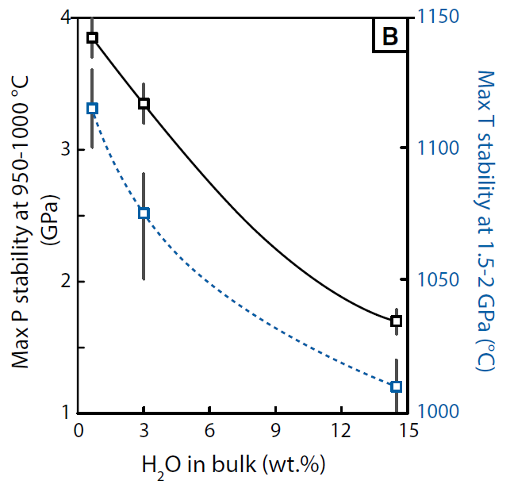
Principal hydrous phases in peridotites
H₂O in bulk (wt%)
Effects of H₂O on pressure (solid black line) and temperature
(dashed blue line) of the amphibole stability.
0
3
6
9
12
15
1
1000
2
1050
Amphibole stability increases with fertility of the mantle and decreases with H₂O content.
Max P stability @ 950-1000 °C (GPa)
Max T stability @ 1.5-2 GPa (°C)
3
1100
@ High H₂O amphibole field is strongly reduced
4
1150
Mandler and Grove, 2016 (Contrib. Mineral. Petrol., 171,68)

Slide 24
Principal hydrous phases in peridotites
When serpentine decomposes, chlorite becomes the dominant hydrous phase.
When amphibole decomposes at T <850 °C water is not liberated, because it can be stored within chlorite.
Temperature (°C)
Water is liberated only between 800-850 °C and the wet solidus (~1000 °C) from the breakdown of amphibole.
400
500
600
700
800
900
1000
1100
tc ol H₂O
amph ol H₂O
opx H₂O
tc ol
opx ol sp H₂O
amph sp opx ol
solidus
serp chl cpx
serp
chl
1
amph chl opx ol
serp chl amph ol
amph ol H₂O
sp
50
2
tc amph
chl ol
amph gar opx ol
gar
chl opx cpx
amph ol
70
The quantity of this fluid is small: in lherzolite, the maximum modal content of amphibole is ~20 wt% (harzburgite <10 wt%) contributing ~0.5 wt% (harzburgite ~0.2 wt%) H₂O.
chl cpx opx ol
cpx gar opx H₂O
3
serp chl cpx ol
chl opx
100
serp
Depth (km)
4
opx ol H₂O
ol gar H₂O
Pressure (GPa)
solidus
cpx opx ol gar
5
serp gar cpx ol
150
ol H₂O
serp phase A
serp phase A cpx gar
Peridotite
+ H₂O
180
6
serp
ol H₂O
200
7
“A” opx H₂O
“A” opx
phase A opx cpx gar
240
0.5 wt% H₂O→0.2*~2.5% H₂O
8
Schmidt and Poli, 1998 (Earth Planet. Sci. Lett., 163, 361-379)

Slide 25
Principal hydrous phases in peridotites
No melting is expected above the chlorite stability (T >870 °C) and below the amphibole stability field (P >~2 GPa) until the wet solidus is reached.
Temperature (°C)
Water is liberated only between 800-850 °C and the wet solidus (~1000 °C) from the breakdown of amphibole.
400
500
600
700
800
900
1000
1100
tc ol H₂O
amph ol H₂O
opx H₂O
tc ol
opx ol sp H₂O
amph sp opx ol
solidus
serp chl cpx
serp
chl
1
amph chl opx ol
serp chl amph ol
amph ol H₂O
sp
50
2
tc amph
chl ol
amph gar opx ol
gar
chl opx cpx
amph ol
70
The quantity of this fluid is small: in lherzolite, the maximum modal content of amphibole is ~20 wt% (harzburgite <10 wt%) contributing ~0.5 wt% (harzburgite ~0.2 wt%) H₂O.
chl cpx opx ol
cpx gar opx H₂O
3
serp chl cpx ol
chl opx
100
serp
No melting even if no hydrous phases are present
Depth (km)
4
opx ol H₂O
ol gar H₂O
Pressure (GPa)
solidus
cpx opx ol gar
5
serp gar cpx ol
150
ol H₂O
serp phase A
serp phase A cpx gar
Peridotite
+ H₂O
180
6
serp
ol H₂O
200
7
“A” opx H₂O
“A” opx
phase A opx cpx gar
240
0.5 wt% H₂O→0.2*~2.5% H₂O
8
Schmidt and Poli, 1998 (Earth Planet. Sci. Lett., 163, 361-379)

Slide 26
Principal hydrous phases in peridotites
1
Possible top-slab cold subduction Geotherm
2
Possible top-slab medium-T subduction Geotherm
3
Average oceanic Geotherm
Many hydrous minerals are stable at T much lower than normal oceanic geotherm.
4
Possible mantle wedge Geotherm
Temperature (°C)
400
500
600
700
800
900
1000
1100
tc ol H₂O
amph ol H₂O
opx H₂O
tc ol
opx ol sp H₂O
amph sp opx ol
solidus
serp chl cpx
serp
chl
4
1
3
amph chl opx ol
serp chl amph ol
amph ol H₂O
sp
50
2
tc amph
chl ol
amph gar opx ol
gar
chl opx cpx
amph ol
70
chl cpx opx ol
cpx gar opx H₂O
The geotherm in the mantle wedge are much higher to much lower than normal oceanic geotherm.
3
serp chl cpx ol
chl opx
100
serp
Depth (km)
4
opx ol H₂O
ol gar H₂O
Pressure (GPa)
1
2
solidus
cpx opx ol gar
5
serp gar cpx ol
150
ol H₂O
serp phase A
serp phase A cpx gar
Peridotite
+ H₂O
180
6
serp
ol H₂O
200
7
“A” opx H₂O
“A” opx
phase A opx cpx gar
8
240
Schmidt and Poli, 1998 (Earth Planet. Sci. Lett., 163, 361-379)

Slide 27
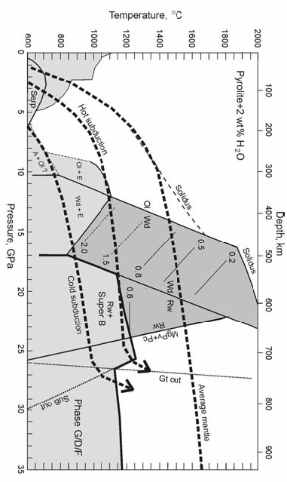
Schematic stability of the hydrous phases in the system CMAS pyrolite + 2 wt% H₂O.
P-T field of the previous diagram.
Pyrolite + 2 wt% H₂O
Serp
Hot
Ol = olivine;
Cpx = clinopyroxene;
Cen = clinoenstatite;
Gt = garnet;
Rw = ringwoodite;
MgPv = Mg-perovskite;
CaPv = Ca-perovskite;
Pc = periclase;
A = DHMS – Phase A;
E = DHMS – Phase E;
SuB = Superhydrous Phase B.
Ol + A
Subduction
Ol + E
Ol
Wd + E
Ol
Wd
2.0
0.5
1.5
0.2
Cold Subduction
0.8
Wd
0.8
Rw
Rw + SuB
Rw
MgPv + Pc
SuB out
Phase G/D/F
Litasov and Ohtani (2003) Phys. Chem. Mineral., 30, 147-156.

Slide 28
Schematic stability of the hydrous phases in the system CMAS pyrolite + 2 wt% H₂O.
Pyrolite + 2 wt% H₂O
Serp
Hot
In simplified systems, the field of the Phase A reaches 10 GPa.
Ol + A
Subduction
Ol + E
Ol
Temperature (°C)
Wd + E
Ol
400
500
600
700
800
900
1000
1100
Wd
tc ol H₂O
amph ol H₂O
opx H₂O
opx ol sp H₂O
serp chl cpx
tc ol
chl
amph sp opx ol
solidus
0.5
1
serp
amph chl opx ol
2.0
0.2
serp chl amph ol
sp
50
1.5
2
tc amph
chl ol
amph ol H₂O
amph gar opx ol
Cold Subduction
0.8
chl opx cpx
amph ol
gar
70
Wd
chl cpx opx ol
cpx gar opx H₂O
3
serp chl cpx ol
0.8
Rw
100
Rw + SuB
Pressure (GPa)
chl opx
serp
Rw
4
opx ol H₂O
ol gar H₂O
solidus
Depth (km)
cpx opx ol gar
MgPv + Pc
5
ol H₂O
serp gar cpx ol
150
serp phase A
serp phase A cpx gar
6
Peridotite
+ H₂O
180
7
serp
ol H₂O
200
SuB out
“A” opx H₂O
“A” opx
phase A opx cpx gar
8
240
Litasov and Ohtani (2003) Phys. Chem. Mineral., 30, 147-156.
Schmidt and Poli, 1998 (Earth Planet. Sci. Lett., 163, 361-379)
Phase G/D/F
Litasov and Ohtani (2003) Phys. Chem. Mineral., 30, 147-156.

Slide 29
Schematic stability of the hydrous phases in the system CMAS pyrolite + 2 wt% H₂O.
Pyrolite + 2 wt% H₂O
Serp
Hot
In simplified systems, the field of the Phase A reaches 10 GPa.
Ol + A
Subduction
Ol + E
Ol
Wd + E
Ol
The stability of Phase E partially overlaps that of wadsleyite.
Wd
2.0
0.5
1.5
0.2
Cold Subduction
0.8
Wd
Wadsleyite can accommodate up to ~3 wt% H₂O. Where this phase is stable, the field of stability of DHMS is reduced.
0.8
Rw
Rw + SuB
Rw
MgPv + Pc
SuB out
Phase G/D/F
Litasov and Ohtani (2003) Phys. Chem. Mineral., 30, 147-156.
Notes:
29

Slide 30
Schematic stability of the hydrous phases in the system CMAS pyrolite + 2 wt% H₂O.
Pyrolite + 2 wt% H₂O
Serp
Hot
DHMS (A, E, superB) cannot exist in pyrolite along a typical mantle geotherm due to their stability being restricted to lower temperature and can occur only under the P–T conditions in slabs descending into the mantle.
Ol + A
Subduction
Ol + E
Ol
Wd + E
Ol
Wd
2.0
0.5
1.5
0.2
Cold Subduction
0.8
Wd
0.8
Rw
Rw + SuB
Rw
Under normal mantle conditions, wadsleyite or ringwoodite are the major H₂O-bearing phases.
MgPv + Pc
SuB out
Phase G/D/F
Litasov and Ohtani (2003) Phys. Chem. Mineral., 30, 147-156.

Slide 31
Schematic stability of the hydrous phases in the system CMAS pyrolite + 2 wt% H₂O.
Pyrolite + 2 wt% H₂O
Serp
Hot
Solidus temperature of Ice VII solid form of H₂O.
Ol + A
Subduction
Ol + E
Ol
Wd + E
Ol
This means that water can be transported in the coldest parts of the slabs also as a polymorph of ice.
Wd
2.0
0.5
1.5
0.2
0.8
Wd
Coldest Subduction
0.8
Rw
Rw + SuB
Rw
MgPv + Pc
SuB out
Phase G/D/F
Litasov and Ohtani (2003) Phys. Chem. Mineral., 30, 147-156.
Notes:
31

Slide 32
Pyrolite + 2 wt% H₂O
Serp
Hot
Ol + A
Subduction
Ol + E
Ol
Wd + E
Ol
Wd
2.0
0.5
1.5
0.2
0.8
Wd
Coldest Subduction
0.8
Rw
Rw + SuB
Rw
MgPv + Pc
SuB out
Phase G/D/F
Notes:
32

Slide 33
Schmidt and Poli (1998)
Pyrolite + 2 wt% H₂O
Serp
Hot
Ol + A
Subduction
Ol + E
Ol
Wd + E
Ol
Wd
2.0
0.5
1.5
0.2
0.8
Wd
Coldest Subduction
0.8
Rw
Rw + SuB
Next Slide
Rw
MgPv + Pc
SuB out
Phase G/D/F
Notes:
33

Slide 34
1: ol±opx±cpx±pl/sp/gt
2: ol+opx+sp+amph
3: ol+opx+gt+amph
4: ol+opx+chl+amph
5: ol+opx+chl+cpx
6: ol+talc+chl+amph
7: ol+serp+chl+amph
8: ol+serp+chl+cpx
9: ol+opx+MgS+cpx
10: ol+serp+gt+cpx
11: A+serp+gt+cpx
12: A+opx+gt+cpx
13: chm+opx+gt+cpx
14: ol+wd±opx±gt±cpx
15:wd±opx/st±gt/mj±cpx
16: E+opx+gt+cpx
17: E+st+gt+cpx
18: E+D+gt+cpx
19: A+D+gt+cpx
20: br+D+gt/mj+cps/Capv
21: rg±st/ak±mj±Capv
22: sB+st+mj+Capv
23: sB+ak+mj+Capv
24: Sb+D+mj+Capv
25: sB+br+gt/mj+Capv
26: br+pe+Capv±Al phase
27: pe+D+gt+Capv
Temperature (°C)
H₂O (wt%)
0
500
1000
1500
2000
2500
0
0
7
6
2
1
Iwamori, 2004 (EPSL, 227, 57-71
4
Hypothetical conductive geotherm
3
8
2
5
5
10
9
1
11
4
1300 °C solid mantle adiabat
10
13
1
12
6
14
14
14
Ol
Wad
Pressure (GPa)
16
15
19
8
18
17
15
Warm slab
10
20
22
Ringw
Br + Pe
20
24
21
12
Extremely cold
slab
23
25
25
Hot slab
26
14
27

Slide 35
Stability of volatile-bearing phases in subduction zones
The variation of T is a fundamental parameter to estimate the stability field of H₂O-CO₂-bearing phases.
The factors controlling the temperature distribution are:
Rate of subduction;
Age (and thus thickness) of the descending slab;
Frictional heating of the upper and lower surfaces of the slab;
Conduction of heat into the slab from the asthenosphere;
Adiabatic heating associated with compression of the slab;
Heat derived from radioactive decay. This is generally low due to the low content of radioactive minerals in oceanic plates;
Latent enthalpy of fusion associated with phase transitions.
Litasov and Ohtani (2003) Phys. Chem. Mineral., 30, 147-156.

Slide 36
The fate of water released from the subducting lithosphere
Water in subducting oceanic crust:
Blueschists of basaltic origin representing shallow portions of subduction zones (10–20 km) have typically 5–6 wt% H₂O bound in hydrous phases.
With a 7 km-thick mafic oceanic crust, composed by equal parts of basalt and gabbro, 0.5–0.6 * 10⁹ g H₂O/m² are bound in the basaltic layer 2 at shallow depth.
Oceanic gabbros are only partially hydrated; with 20–30% hydration by volume ~0.11-0.18*10⁹ g H₂O/m² are estimated for the gabbroic layer.
An additional amount of 0.01-0.02*10⁹ g H₂O/m² will be subducted in the sedimentary layer (200–400 m thick).
Schmidt and Poli, 1998 (Earth Planet. Sci. Lett., 163, 361-379)

Slide 37
The fate of water released from the subducting lithosphere
Water in subducting oceanic crust:
In a vertical section of 1 m², typical dehydration rates between 20 and 70 km depth amount to 0.8 ±0.2*10⁷ g H₂O (~10 Ton) per km of depth.
When the oceanic crust reaches depths of 70–80 km the resulting metamorphic assemblage retains 0.5-1 wt% H₂O, i.e. 0.1-0.2 * 10⁹ g H₂O/m².
Schmidt and Poli, 1998 (Earth Planet. Sci. Lett., 163, 361-379)

Slide 38
The fate of water released from the subducting lithosphere
Only a portion of the H₂O initially contained in the subducting lithosphere will escape from the slab in the depth range suitable for arc magma formation.
A large portion of H₂O will be dehydrated at relatively shallow levels and a small portion will fade into the deeper mantle.
Schmidt and Poli, 1998 (Earth Planet. Sci. Lett., 163, 361-379)

Slide 39
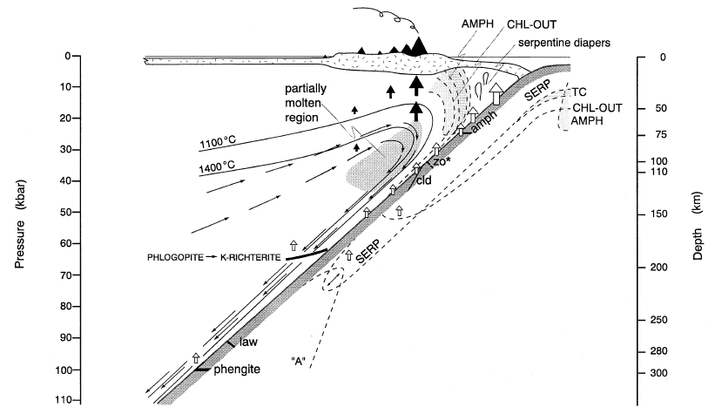
Model for the formation of the volcanic front
Dehydration from peridotite and oceanic crust occurs at almost any depth down to ~150–200 km, thus water will be generally available above the subducting lithosphere.
Rise of fluids
Rise of melts
Schmidt and Poli, 1998 (Earth Planet. Sci. Lett., 163, 361-379)

Slide 40
Model for the formation of the volcanic front
The volcanic front forms where the amount of melt is sufficient to mechanically extract and give rise to arc magmatism.
Rise of fluids
Rise of melts
Schmidt and Poli, 1998 (Earth Planet. Sci. Lett., 163, 361-379)

Slide 41
Model for the formation of the volcanic front
Typical models involve a multistage process:
Dehydration of the slab at a variable and relatively shallow depths;
Intermediate storage of H₂O (and trace elements deriving from the subducted slab) in a single, key hydrous phase in the mantle wedge (typically amphibole);
Subsequently the down-dragged mantle wedge dehydrates;
Melting occurs above this dehydration zone or
Melting of the mantle wedge occurs on the wet solidus of peridotite.
A number of hydrous phases have been called on to explain such transient storage of H₂O and of other ‘metasomatizing components’ within the mantle wedge.
Kearey et al., 2008 (Global Tectonics. Wiley-Blackwell Publ. 482 pp)

Slide 42
Model for the formation of the volcanic front
Typical models involve a multistage process:
Amphibole contributes moderately to the water budget. This phase has a relatively small contribution to the water budget of peridotite (~0.2-0.5 wt% H₂O of the bulk rock) with respect to the other hydrous phases.
Therefore it has been supposed that the role of amphibole is not outstanding with respect to other hydrous phases.
Amphibole cannot constitute the only fluid source situated below the volcanic front.
Schmidt and Poli, 1998 (Earth Planet. Sci. Lett., 163, 361-379)

Slide 43
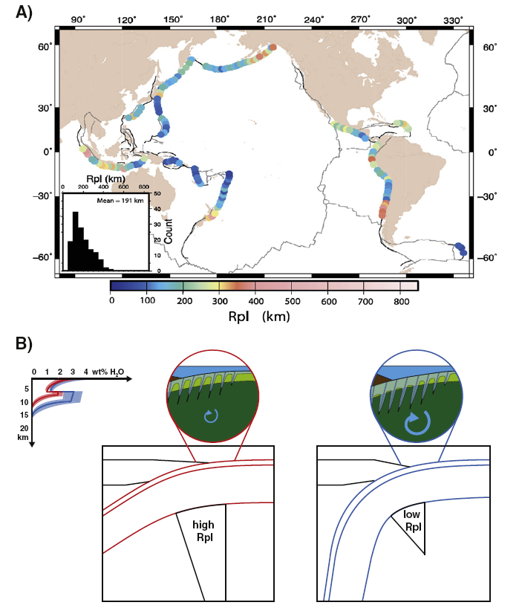
Rpl = Radius of a plastic plate
Rpl calculated from the earthquake hypocentres across different segments of subduction zones.
High Rpl =
low bending =
low hydration
Low Rpl =
high bending =
high hydration
Average Rpl = 191 km
Faccenda, 2014 (Tectonophysics, 614, 1-30)

Slide 44
Average water content is ~3 wt% in basalt, 1 wt.% in gabbros and up to ~4 wt% (~30% serpentinization) in the hydrated mantle depending on the amount of bending.
Serpentine: ~13% H₂O
30% Serp. = ~13% H₂O*0.3 = ~4%
Vigorous hydrothermal convection and pervasive hydration is promoted in steeply dipping slabs.
Faccenda, 2014 (Tectonophysics, 614, 1-30)

Slide 45
Next slide
Riguzzi et al., 2010 (Tectonophysics, 484, 60-73)

Slide 46
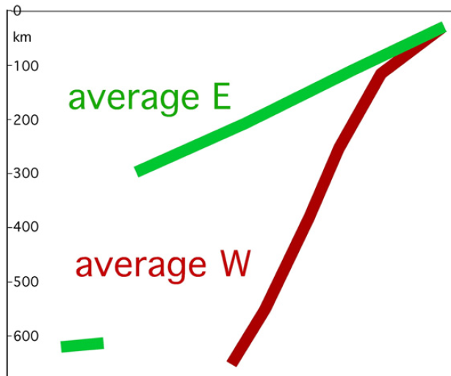
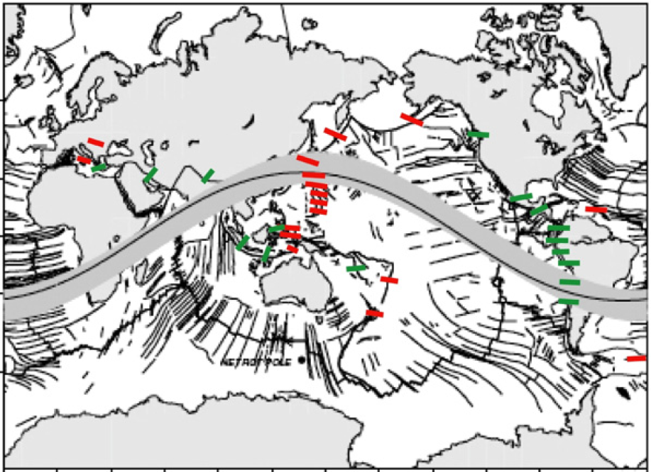
Riguzzi et al., 2010 (Tectonophysics, 484, 60-73)
Is there a real dichotomy between the Rpl (or slab dips) of the western and eastern Pacific Ocean subductions?
Faccenda, 2014 (Tectonophysics, 614, 1-30)

Slide 47
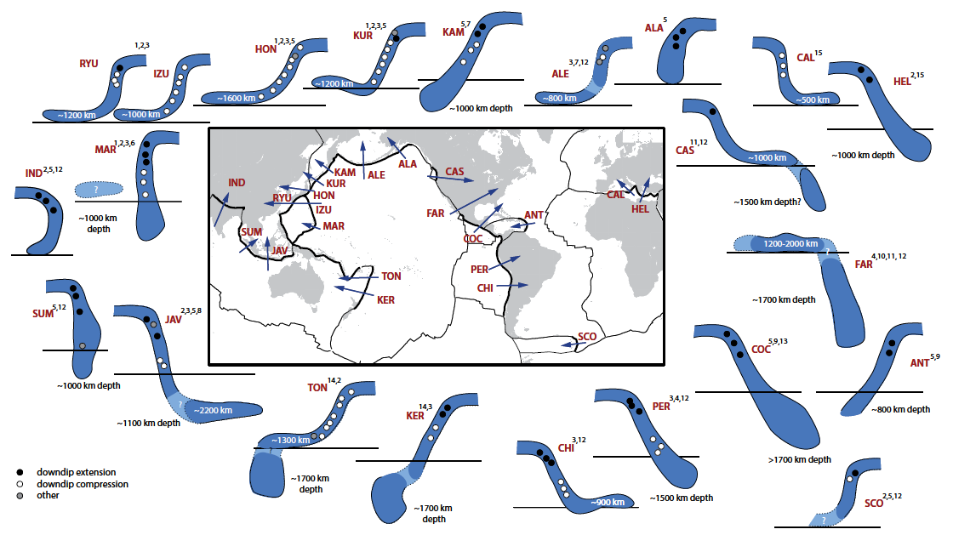
Riguzzi et al., 2010 (Tectonophysics, 484, 60-73)
Goes et al., 2017 (Geosphere, 13, 3 doi:10.1130/GES01476.1)

Slide 48
Model for the formation of the volcanic front
Typical models involve a multistage process:
Fluids rise from the subducting slab and hydrate a portion of the overlying mantle wedge at almost any depth to ~150–200 km.
At a given depth, several hydrous phases will decompose through either discontinuous or continuous reactions.
Dehydration at low pressures is almost entirely due to potassium-free phases, whereas at pressures above 3 GPa, phengite (phlogopite) becomes more and more important (if sufficient K is available).
Schmidt and Poli, 1998 (Earth Planet. Sci. Lett., 163, 361-379)

Slide 49
Model for the formation of the volcanic front
Typical models involve a multistage process:
The consequence is that H₂O-rich fluids with a variable geochemical signal will be generally available above subducting lithosphere to at least 150–200 km depth.
The key aspect for generating partial melts in the mantle wedge is the CORNER FLOW below volcanic fronts.
Without this corner flow, mantle wedge temperatures would rapidly reduce and arc magmatism would cease.
Schmidt and Poli, 1998 (Earth Planet. Sci. Lett., 163, 361-379)

Slide 50
Model for the formation of the volcanic front
Rise of fluids
Rise of melts
Schmidt and Poli,1998, (Earth Planet. Sci. Lett., 163, 361-379)

Slide 51
Model for the formation of the volcanic front
Subduction zones on Earth form a ~55,000 km-long zone where sediments, oceanic crust and mantle lithosphere return to (and re-equilibrate with) Earth’s mantle.
Asthenospheric mantle is sucked toward the trench by the sinking slab (the previous corner flow effect) and interacts with water and incompatible elements rising from the sinking plate.
This interaction causes the mantle to melt.

Slide 52
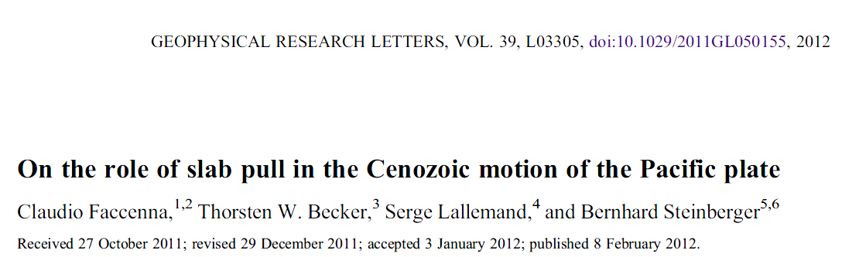
Model for the formation of the volcanic front
According to many researchers the sinking of lithosphere in subduction zones provides most of the force needed to drive the plates and cause mid-ocean ridges to spread.
I disagree with this hypothesis.
(but this does not mean that this hypothesis is necessarily wrong. Maybe I am wrong).
This is called the Slab-pull tectonics

Slide 53
Model for the formation of the volcanic front
Not everything is recycled in the upper few hundred kilometres of a subduction zone.
A large volume of subducting plate sinks down to the mantle.
The residuum of the subducting plate possibly accumulates to the 670 km discontinuity or it can founder down to the core-mantle boundary layer at ~2900 km.
Why should the subducted plate accumulate at the 670 km discontinuity?
…remember the ringwoodite → bridgmanite + Fe periclase transition…
And remember also the density contrast between slab and lower mantle.
ρ <3.8 g/cm³
ρ >3.8 g/cm³

Slide 54
All minerals in the slab lithologies (sediments, basalt/gabbro crust and peridotite) have densities <3.8g/cm³.
410 km
560 km
660 km
Stixrude and Lithgow-Bertelloni, 2011 (Geophys. J. Int., 184, 1180-1213)
Notes:
Il gradiente isentropico è uguale al gradient adiabatico (senza scambio di calore). A differenza del G. adiabatico, che può essere reversibile o irreversibile, il G. isentropico è sempre reversibile.

Slide 55
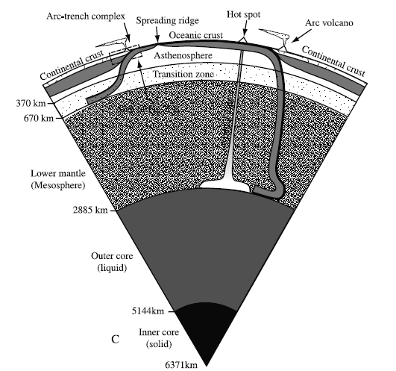
Model for the formation of the volcanic front
?
Ringwoodite
Bridgmanite+ Fe Periclase
X
We will discuss in more detail the possibility of involvement of recycled slabs stored at CMB layer
Lower Mantle
Liquid Core
Stern, 2002 (Rev. Geophys., 40, doi:10.1029/2001RG000108)

Slide 56
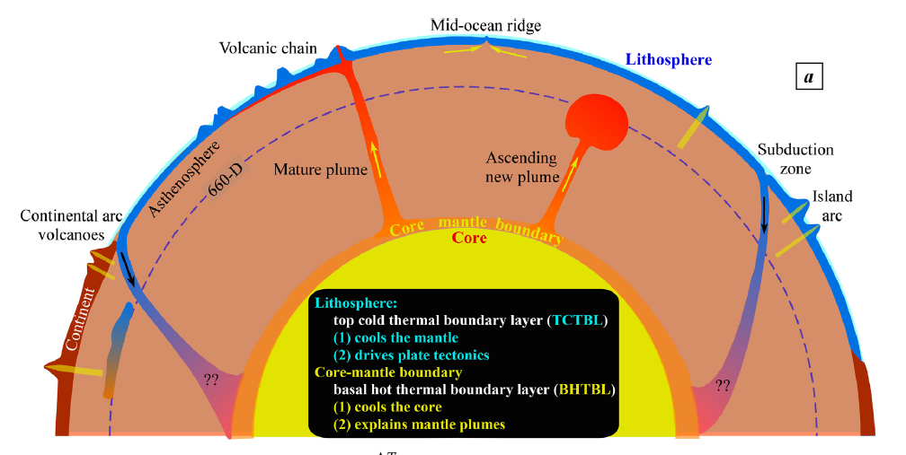
Model for the formation of the volcanic front
State-of-the-art conceptual understanding of plate tectonics theory, including subduction dynamics and mantle plume hypothesis.
Niu, 2020 (J. Asian Earth Sci., 194, 104367)

Slide 57
Model for the formation of the volcanic front
Whatever is the correct model (i.e., slabs folding and accumulating at 670 or 2900 km discontinuities), ~10⁶ kg H₂O each m² of oceanic lithosphere is carried to greater than 20 km depth, corresponding to the base of the overlying crust.
30-70% of the subducted water is released below the forearc, where it will likely serpentinize the overlying mantle, and another 18-37% of the subducted water will persist to depths where it might help generate arc magmas.
Stern, 2002 (Rev. Geophys., 40, doi:10.1029/2001RG000108)

Slide 58
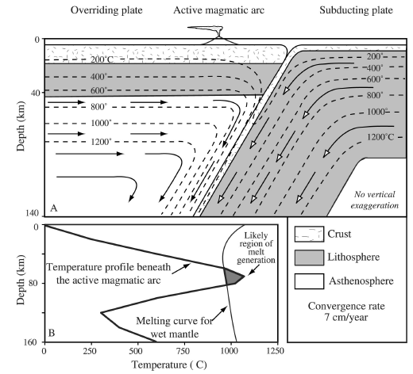
Model for the formation of the volcanic front
Material movement (arrows) and temperature structure (dashed lines) of a simplified convergent margin.
Stern, 2002 (Rev. Geophys., 40, doi:10.1029/2001RG000108)

Slide 59
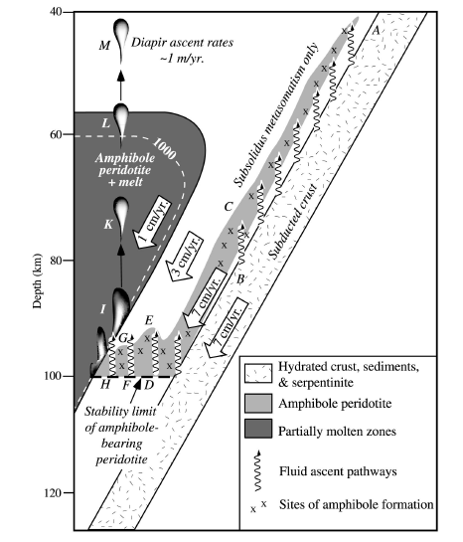
Model for the formation of the volcanic front
Detailed cartoon of the mantle wedge, showing how fluids might move from the subducted slab into a region where melts could be generated.
Temperature (°C)
900
1000
1100
MORB pyrolite
-40% olivine
(+ 0.6% H₂O)
1
Pl-out
Amphibole Lherzolite
Lherzolite + melt
Pressure (GPa)
2
Gar-in
From: Niida and Green (1999) Contrib. Mineral. Petrol., 135, 18-40
3
Amph-out
Stern, 2002 (Rev. Geophys., 40, doi:10.1029/2001RG000108)

Slide 60
Model for the formation of the volcanic front
Detailed cartoon of the mantle wedge, showing how fluids might move from the subducted slab into a region where melts could be generated.
Here water-saturated conditions and high temperature are attained. Partial melts are produced.
Here water-saturated conditions are attained. However no partial melts are produced because the temperature is too much low.
Stern, 2002 (Rev. Geophys., 40, doi:10.1029/2001RG000108)
Notes:
60

Slide 61
Model for the formation of the volcanic front
Detailed cartoon of the mantle wedge, showing how fluids might move from the subducted slab into a region where melts could be generated.
Temperature (°C)
900
1000
1100
MORB pyrolite
-40% olivine
(+ 0.6% H₂O)
1
Pl-out
Amphibole Lherzolite
Lherzolite + melt
Pressure (GPa)
2
Gar-in
From: Niida and Green (1999) Contrib. Mineral. Petrol., 135, 18-40
3
Amph-out
Stern, 2002 (Rev. Geophys., 40, doi:10.1029/2001RG000108)
Notes:
61

Slide 62
Model for the formation of the volcanic front
Kimura et al., 2009 (Geochem. Geophys. Geosyst., 10, doi:10.1029/2008GC002217)
Temperature (°C)
400
500
600
700
800
900
1000
1100
tc ol H₂O
amph ol H₂O
opx H₂O
opx ol sp H₂O
amph sp opx ol
solidus
serp chl cpx
tc ol
chl
1
serp
amph chl opx ol
2
serp chl amph ol
amph ol H₂O
amph gar opx ol
sp
50
tc amph
chl ol
amph ol
gar
70
chl opx cpx
cpx gar opx H₂O
3
serp chl cpx ol
chl cpx opx ol
100
Dehydration of subducted sediment and altered oceanic crust.
serp
chl opx
1
4
opx ol H₂O
ol gar H₂O
solidus
Depth (km)
Pressure (GPa)
cpx opx ol gar
Hydration of mantle wedge and reaction with slab-derived fluid
5
serp gar cpx ol
150
2.1
ol H₂O
serp phase A cpx gar
6
serp phase A
Peridotite
+ H₂O
180
2.2
Fluid flow in the mantle and fluid-mantle reaction
serp
ol H₂O
200
7
“A” opx H₂O
“A” opx
phase A opx cpx gar
3
Fluid-fluxed melting of the mantle wedge
8
240
From: Schmidt and Poli (1998) Earth Planet. Sci. Lett., 163, 361-379

Slide 63
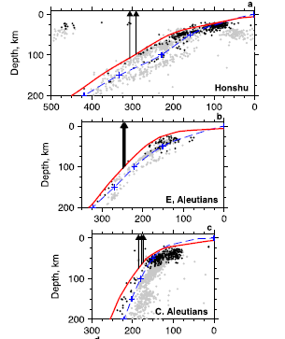
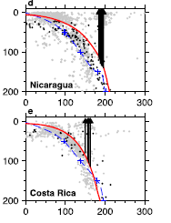
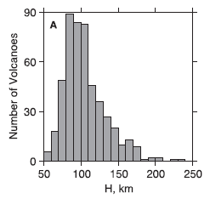
Model for the formation of the volcanic front
Partial melting at what depth?
H
Temperature (°C)
400
500
600
700
800
900
1000
1100
(km)
1
2
50
Amph-out range
3
100
Pressure (GPa)
4
solidus
5
150
6
Peridotite
+ H₂O
7
200
8
240
Peak at ~70-110 km depth
Syracuse and Abers, 2006 (Geochem. Geophys. Geosyst., 7, doi:10.1029/2005GC001045)

Slide 64
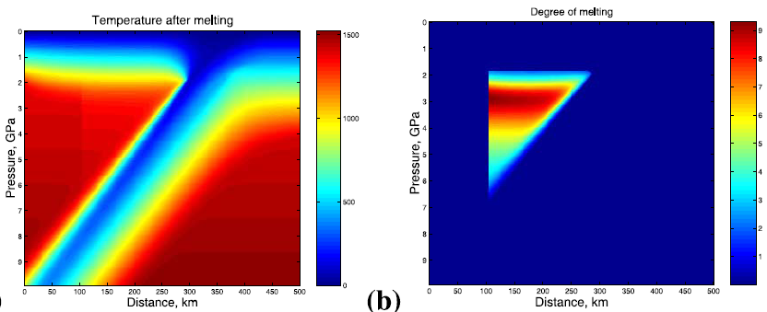
Degree of melting
0
9
1
8
2
7
3
6
4
5
5
Pressure (GPa)
4
Temperature (°C)
6
400
500
600
700
800
900
1000
1100
3
(km)
7
1
2
50
8
2
Amph-out range
3
100
9
1
Pressure (GPa)
4
solidus
5
150
6
Peridotite
+ H₂O
7
200
8
240
Peak at ~70-110 km depth
Katz et al., 2003 (Geochem. Geophys. Geosyst. doi:10.1029/2002GC000433)
Notes:
64

Slide 65
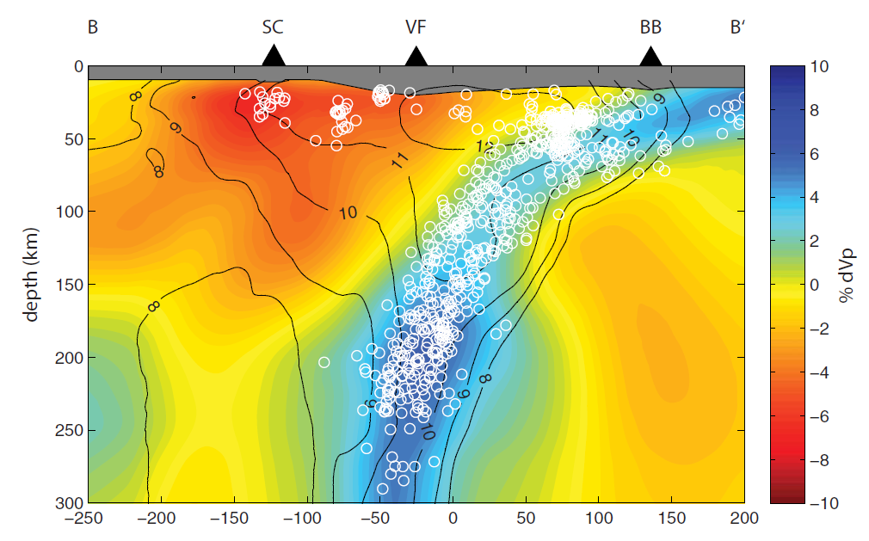
Barklage et al., 2015 (Geochem. Geophys. Geosyst., 16, 681-704)
Notes:
65

Slide 66
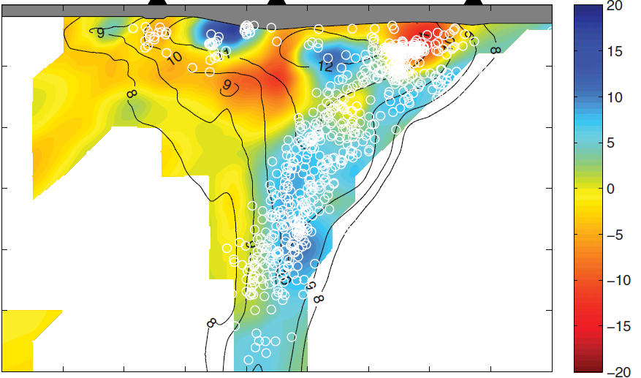
Vs (km/s)
Barklage et al., 2015 (Geochem. Geophys. Geosyst., 16, 681-704)
Notes:
66

Slide 67
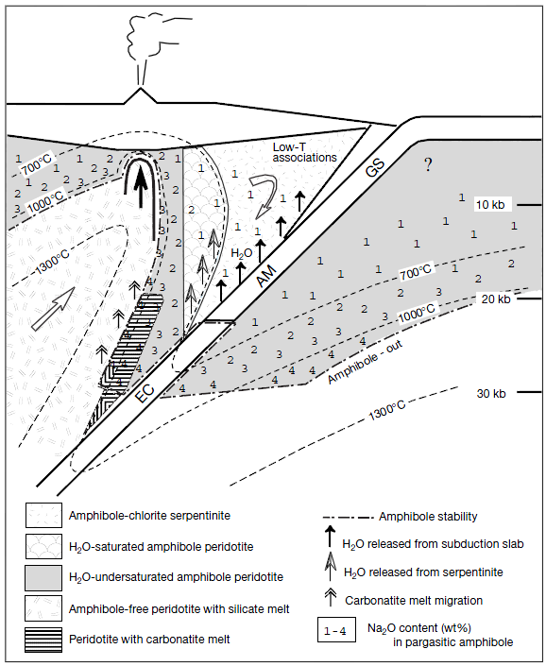
Niida and Green, 1999 (Contrib. Mineral. Petrol., 135, 18-40)
Temperature (°C)
400
500
600
700
800
900
tc ol H₂O
amph sp opx ol
amph ol H₂O
opx H₂O
tc ol
opx ol sp H₂O
serp chl cpx
serp
chl
1
amph chl opx ol
serp chl amph ol
amph ol H₂O
700 °C
2
tc amph
chl ol
chl opx cpx
1000 °C
Pressure (GPa)
chl cpx opx ol
3
serp chl cpx ol
chl opx
1300 °C
serp
700 °C
4
opx ol H₂O
ol gar H₂O
1000 °C
5
1300 °C
At low P (<2.5 GPa) and low T (<700 °C) the hydrated peridotite is serpentine-chlorite-amphibole-bearing
At low P (<2.5 GPa) and high T (>700 °C) the hydrated peridotite is amphibole-bearing
Notes:
67

Slide 68
Temperature (°C)
Niida and Green, 1999 (Contrib. Mineral. Petrol., 135, 18-40)
600
700
800
900
1000
1100
opx H₂O
tc ol
opx ol sp H₂O
solidus
tc ol H₂O
chl
amph sp opx ol
1
serp
amph chl opx ol
amph ol H₂O
amph gar opx ol
sp
2
tc amph
chl ol
chl opx cpx
amph ol
gar
700 °C
Pressure (GPa)
chl cpx opx ol
cpx gar opx H₂O
1000 °C
3
chl opx
serp
4
opx ol H₂O
ol gar H₂O
1300 °C
solidus
700 °C
5
1000 °C
To increase the complexity, note that the slab-released fluid is CO₂-H₂O dominated, therefore also carbonatitic melt is expected to form under these circumstances.
1300 °C
When the temperature raises up to ~1000 °C the amphibole is no longer stable and hydrous silicate melt is produced at wet mantle solidus.
Notes:
68

Slide 69
Temperature (°C)
Niida and Green, 1999 (Contrib. Mineral. Petrol., 135, 18-40)
600
700
800
900
1000
1100
opx H₂O
tc ol
opx ol sp H₂O
solidus
tc ol H₂O
chl
amph sp opx ol
1
serp
amph chl opx ol
amph ol H₂O
amph gar opx ol
sp
2
tc amph
chl ol
chl opx cpx
amph ol
gar
700 °C
Pressure (GPa)
chl cpx opx ol
cpx gar opx H₂O
1000 °C
3
chl opx
serp
4
opx ol H₂O
ol gar H₂O
1300 °C
solidus
700 °C
5
1000 °C
To increase the complexity, note that the slab-released fluid is CO₂-H₂O dominated, therefore also carbonatitic melt is expected to form under these circumstances.
1300 °C
When the temperature raises up to ~1000 °C the amphibole is no longer stable and hydrous silicate melt is produced at wet mantle solidus.
Notes:
69

Slide 70
Model for the formation of the volcanic front
What type of magmas are produced?
Convergent margin magmas typically have geochemical signatures that include:
- Elevated concentrations of Large-Ion Lithophile Elements (LILE) and Light Rare Earth Elements (LREE);
Depleted Heavy Rare Earth Elements (HREE) and High Field Strength Elements (HFSE);
Elevated Pb;
- Typically radiogenic Sr, Pb, and unradiogenic Nd isotopic compositions.
LILE? = Cs, Rb, Sr, K, Ba, etc.
HREE? = Ho, Er, Yb, Lu
HFSE? = Ti, Nb, Ta, Zr, Hf
Kimura et al., 2009 (Geochem. Geophys. Geosyst., 10, doi:10.1029/2008GC002217)

Slide 71
Model for the formation of the volcanic front
What type of magmas are produced?
These geochemical characteristics have been attributed to the melting of depleted mantle peridotite by the fluxing of fluids or melts derived from subducting oceanic crust.
The difference in contributions from the subducted slab found among various arcs appears to be mostly controlled by thermal structure:
Cold slabs yield fluids, hot slabs yield melts.
The origin of arc lavas is related to:
- Melting of mantle wedge metasomatized by slab-derived fluid or melt or
Direct supply of felsic melt from eclogitic slab melting.
Combined slab fluid and melt fluxes have also been proposed to explain geochemical variations along or across magmatic arcs.
Kimura et al., 2009 (Geochem. Geophys. Geosyst., 10, doi:10.1029/2008GC002217)

Slide 72
Model for the formation of the volcanic front
What type of magmas are produced?
It is possible to say that:
Two major but contrasting proposals exist to explain arc magma genesis.
The first invokes the dehydration of oceanic plate slab whereas the other predicts direct melting of the slab.
The fundamental control appears to be the pressure-temperature path of the subducting slab.
In these models with an isoviscous mantle wedge, subduction of old and cold oceanic plate leads to low slab surface temperature. Subduction of young and hot oceanic crust results in higher slab surface temperatures.
Kimura et al., 2009 (Geochem. Geophys. Geosyst., 10, doi:10.1029/2008GC002217)

Slide 73
Model for the formation of the volcanic front
What type of magmas are produced?
The thermal regime of subduction zones can be categorized into two stages in both time and space.
First stage: Compressional tectonism at low thermal gradients.
Metamorphic dehydration of the subducting crust prevails at forearc to sub-arc depths due to the breakdown of hydrous minerals such as mica and amphibole in the stability field of garnet and rutile
This results in the liberation of aqueous solutions with the trace element composition that is considerably enriched in LILE, Pb and LREE but depleted in HFSE and HREE relative to normal MORB.
These processes provide the crustal signature for the mantle sources of IAB.
IAB = Island Arc Basalts
Zheng, 2019 (Geosci. Front. , 10, 1223-1254)

Slide 74
Model for the formation of the volcanic front
What type of magmas are produced?
The thermal regime of subduction zones can be categorized into two stages in both time and space.
Second stage: Extensional tectonism at high thermal gradients.
Partial melting of dehydrated crustal rocks at sub-arc to post-arc depths. This involves not only the breakdown of hydrous minerals such as amphibole, phengite and allanite, but also the dissolution of rutile into hydrous melts.
These melts can acquire the trace element composition that is significantly enriched in LILE, HFSE and LREE but depleted in Pb and HREE relative to normal MORB
These latter geochemical characteristics provide the crustal signature for the mantle sources of OIB.
OIB = Ocean Island Basalts
Zheng, 2019 (Geosci. Front. , 10, 1223-1254)

Slide 75
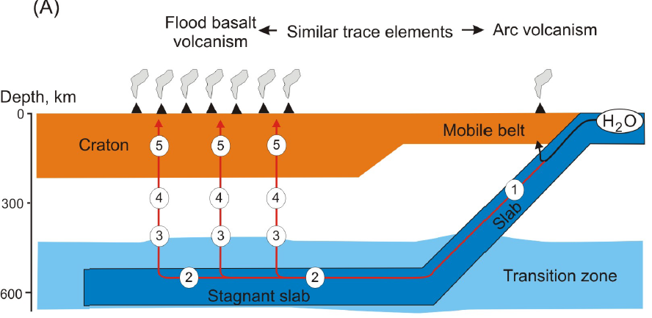
Model for the formation of the volcanic front
What type of magmas are produced?
Second stage: OIB = Ocean Island Basalts
CFB = Continental Flood Basalts
First stage: IAB = Island Arc Basalts
Mantle Wedge
Stagnant slab
Ivanov et al., 2015 (GSA-AGU Spec. Paper 514)

Slide 76
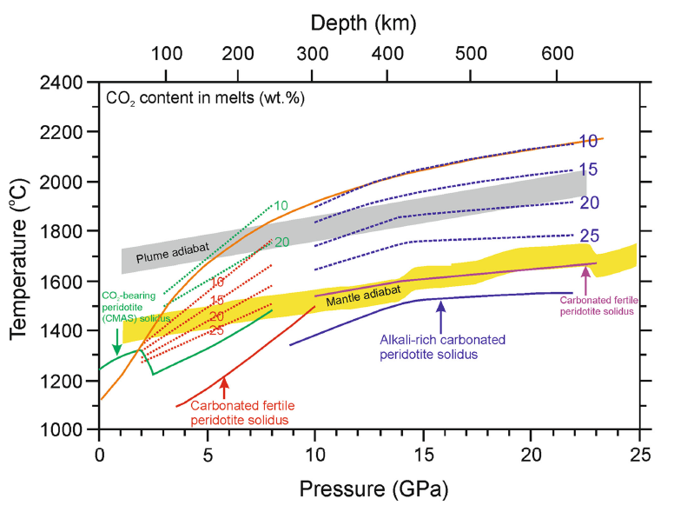
Model for the formation of the volcanic front
What type of magmas are produced?
Solidi of carbonated and hydrated basaltic and pelitic lithologies
Second stage: OIB = Ocean Island Basalts
CFB = Continental Flood Basalts
CAMS-CO₂
(Dalton and Presnall 1998)
First stage: IAB = Island Arc Basalts
Dasgupta et al. (2004)
Volatile-free peridotite solidus (Herzberg et al 2000; KLB1)
H
Hammouda (2003)
W
Carbonated fertile peridotite (Dasgupta and Hirschmann, 2006)
C
Grassi and Schmidt (2011)
Thomson et al. (2013)
Keshav and Gudfinnsson (2010)
1350 °C solid mantle adiabat
Mantle Wedge
Kiseeva al. (2013)
Stagnant slab
Ivanov et al., 2015 (GSA-AGU Spec. Paper 514)

Slide 77
Model for the formation of the volcanic front
What type of magmas are produced?
Second stage: OIB = Ocean Island Basalts
CFB = Continental Flood Basalts
First stage: IAB = Island Arc Basalts
Zheng, 2019 (Geosci. Front., 10, 1223-1254)

Slide 78
Model for the formation of the volcanic front
What type of magmas are produced?
Second stage: OIB = Ocean Island Basalts
CFB = Continental Flood Basalts
First stage: IAB = Island Arc Basalts
“Because such sources can be generated by the crust-mantle interaction at the post-arc depths above the mantle transition zone, it is intriguing whether it is necessary to invoke the origin of OIB from mantle plumes at the core-mantle boundary”.
Zheng, 2019 (Geosci. Front., 10, 1223-1254)

Slide 79
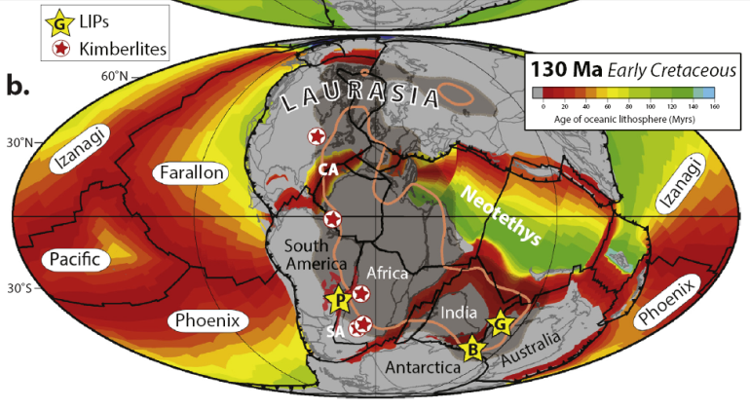

Model for the formation of the volcanic front
What type of magmas are produced?
Second stage: OIB = Ocean Island Basalts
CFB = Continental Flood Basalts
First stage: IAB = Island Arc Basalts
Mantle plumes triggered by subduction
TUZO Large Low Shear-wave Velocity Province
P
G
B
Torsvik, 2019 (Tectonophysics, 760, 297-313)

Slide 80
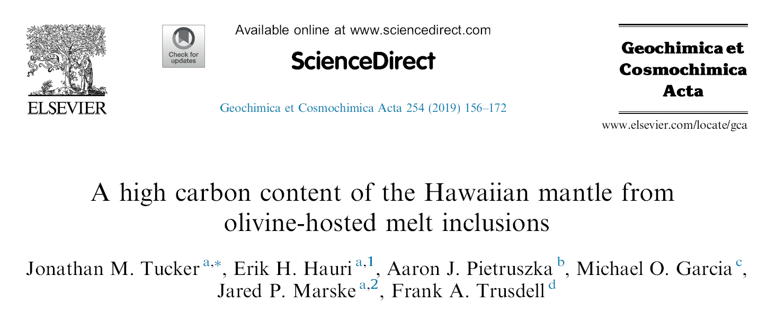
Model for the formation of the volcanic front
What type of magmas are produced?
Second stage: OIB = Ocean Island Basalts
CFB = Continental Flood Basalts
First stage: IAB = Island Arc Basalts
“If surficial C is subducted in association with recycled crust, the higher C concentration in the Hawaiian mantle could reflect preferential delivery of subducted C to the deep mantle source of Hawaii, compared to the shallower MORB mantle. This scenario is consistent with geodynamic
and mass balance arguments for predominantly surface derived mantle C and the inference that the Hawaiian mantle contains significant amounts of subducted material.”

Slide 81
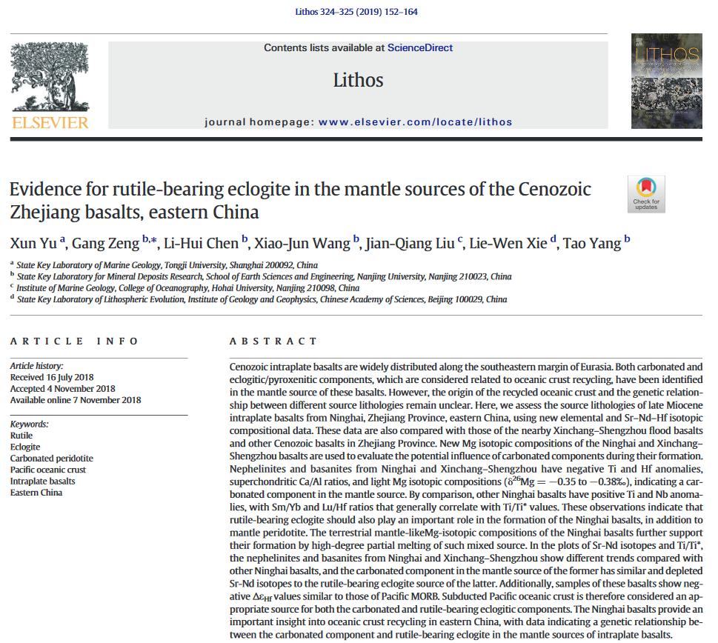

Model for the formation of the volcanic front
What type of magmas are produced?

Slide 82
Model for the formation of the volcanic front
What type of magmas are produced?
Subduction generates strong thermal and chemical disequilibrium, leading to dehydration and hydration, mineral transformations, and partial melting of crustal and mantle rocks.
This results in different types of subduction zone processes such as metamorphism, metasomatism and magmatism.
Crustal recycling at convergent plate boundaries has been accepted as the fundamental mechanism for geochemical heterogeneity of the mantle.
The trace element and radiogenic isotope composition of subduction zone magmas is primarily dictated by element transfer from the subducting crust into the overlying mantle wedge.
Zheng, 2019 (Geosci. Front., 10, 1223-1254)

Slide 83
Model for the formation of the volcanic front
What type of magmas are produced?
Amph out range
Zheng, 2019 (Geosci. Front., 10, 1223-1254)

Slide 84
Model for the formation of the volcanic front
What type of magmas are produced?
Fluid/solid partition coefficients for MORB-water systems at mantle conditions.
Elements compatible in fluids/melts
(Transferred to the mantle wedge)
Elements incompatible in fluids/melts
(Remain in the solid residuum)
Zheng, 2019 (Geosci. Front., 10, 1223-1254)

Slide 85
Model for the formation of the volcanic front
What type of magmas are produced?
A prominent difference in trace element composition between IAB and OIB is the abundance of Nb and Ta in the primitive mantle-normalized diagram.
~70-80
~6-7
Zheng, 2019 (Geosci. Front., 10, 1223-1254)

Slide 86
Model for the formation of the volcanic front
What type of magmas are produced?
Rutile is a key host mineral for Nb and Ta.
Zheng, 2019 (Geosci. Front., 10, 1223-1254)
Aqueous solutions produced by metamorphic dehydration in the rutile stability field are depleted in Nb and Ta (→IAB).
On the other hand, the abundances of Nb and Ta are elevated in hydrous melts or supercritical fluids if rutile breaks down (→OIB).

Slide 87
Model for the formation of the volcanic front
What type of magmas are produced?
Betic Lamproites (SE Spain)
GLOSS =
GLObal Subducting Sediments
Note the strong match between sediments and whole-rock lamproite compositions.
Conticelli et al., 2009 (Lithos, 107, 68-92)

Slide 88
Model for the formation of the volcanic front
What type of magmas are produced?
Betic Lamproites (SE Spain)
What is important is not the absolute content of a given element, but, rather, the interelemental fractionation (e.g., the HFSE/LILE ratios or Ce/Pb or Nb/U ratios)
GLOSS =
GLObal Subducting Sediments
Note the strong match between sediments and whole-rock lamproite compositions.
Conticelli et al., 2009 (Lithos, 107, 68-92)

Slide 89
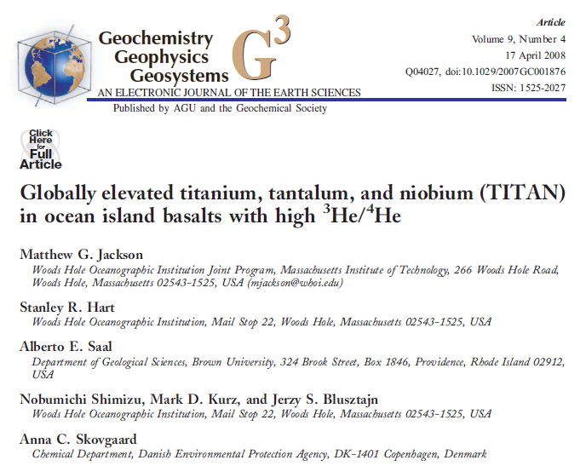
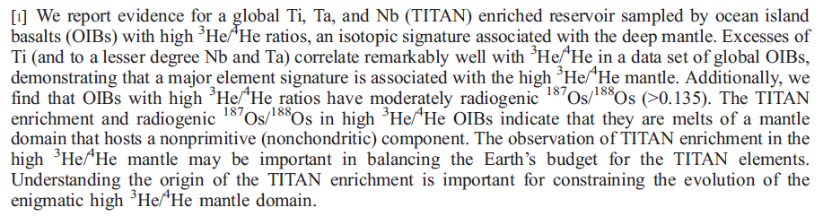
Jackson et al., 2008 (G3, 9, doi:10.1029/2007GC001876)

Slide 90
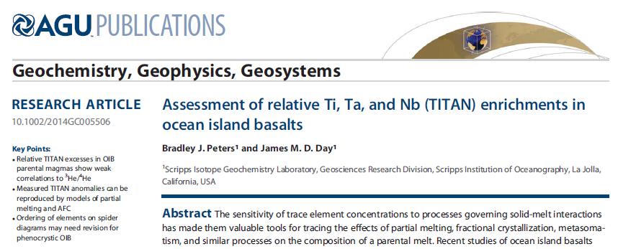
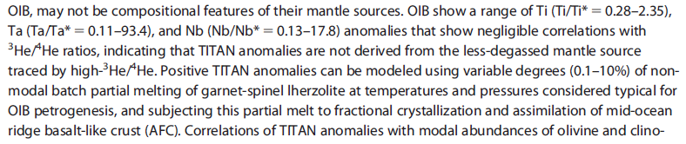
Peters and Day (2014), G3,15, 4424–4444

Slide 91
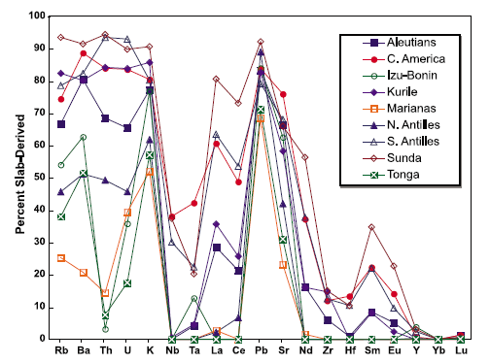
Model for the formation of the volcanic front
Percentage of each element in arc-magmas derived from subducting oceanic crust and sediment.
What do these two diagrams indicate?
LILE, LREE and Pb in arc-magmas in many natural cases derive mostly from the subducting slab;
- Subducting slab (altered oceanic crust + sediments) are chemically very different from MORB.
What do the negative HFSE anomaly in IAB indicate?
Porter and White, 2009 (Geochem. Geophys. Geosyst., 10, doi:10.1029/2009GC002656)

Slide 92
Credits:
Barklage et al. (2015) Geochem. Geophys. Geosyst., 16, 681-704
Conticelli et al (2009) Lithos, 107, 68-92
Faccenda (2014) Tectonophysics, 614, 1-30
Faccenna et al. (2012) Geophys. Res. Lett., 39, L03305
Frost (2008) Elements, 4, 171-176
Fumagalli and Poli (2005) J. Petrol., 46, 555-578
Goes et al. (2017) Geosphere, 13, 3 doi:10.1130/GES01476.1
Katz et al. (2003) Geochem. Geophys. Geosyst., doi: 10.1029/2002GC00043
Kearey et al. (2008) Global Tectonics. Wiley-Blackwell Publ. 482 pp.
Kimura et al. (2009) Geochem. Geophys. Geosyst., 10, doi:10.1029/2008GC002217
Jackson et al (2008) Geochem. Geophys. Geosyst., 9, doi:10.1029/2007GC001876
Ivanov et al. (2015) GSA-AGU Spec. Paper 514
Iwamori (2004) Earth Planet. Sci. Lett., 227, 57-71
Litasov and Ohtani (2003) Phys. Chem. Mineral., 30, 147-156
Mandler and Grove, 2016 (Contrib. Mineral. Petrol., 171, 68 DOI 10.1007/s00410-016-1281-5)
Niida and Green (1999) Contrib. Mineral. Petrol., 135, 18-40
Niu (2020) J. Asian Earth Sci., 194, 104367
Peters and Day (2014) Geochem. Geophys. Geosyst., 15, 4424-4444
Porter and White (2009) Geochem. Geophys. Geosyst., 10, doi:10.1029/2009GC002656
Riguzzi et al (2010) Tectonophysics, 484, 60-73
Schmidt and Poli (1998) Earth Planet. Sci. Lett., 163, 361-379
Stern (2002) Rev. Geophys., 40, doi:10.1029/2001RG000108
Syracuse and Abers (2006) Geochem. Geophys. Geosyst., 7, doi:10.1029/2005GC001045
Stixrude and Lithgow-Bertelloni (2011) Geophys. J. Int., 184, 1180-1213
Torsvik (2019) Tectonophysics, 760, 297-313
Tucker et al. (2019) Geochim. Cosmochim. Acta, 254, 156-172
Xu et al. (2019) Lithos, 324-325, 152-164
Zheng (2019) Geosci. Front., 10, 1223-1254)
You can use this material for scientific and non-scientific purposes.
Please quote and acknowledge the source of data

